Slide 1
MODULE 15-16: QUALITY MANAGEMENT IN PROJECT MANAGEMENT
DITTAS FORMOSO

Slide 2
LEARNING OUTCOMES
Understand the concept of quality and quality management
Know the different phases of project quality management
Know the benefits of project quality management

Slide 3
WHAT IS QUALITY?
Quality refers to how good something is compared to other similar things. In other words, its degree of excellence. ... The ISO 8402-1986 standard defines quality as: “The totality of features and characteristics of a product or service that bears its ability to satisfy stated or implied needs.”

Slide 4
WHAT IS THE DEFINITION OF QUALITY IN PROJECT QUALITY MANAGEMENT
The definition of quality is central to understanding the three quality processes. To be able to define quality, you need to be clear about the meaning of the following terms:
Validation: assurance that the product meets the agreed-upon needs
Verification: compliance with requirements
Precision: repeatable measures in a tight grouping
Accuracy: closeness of a measure to the true value
Tolerance: range of acceptable results

Slide 5
WHAT IS PROJECT QUALITY MANAGEMENT
Project quality management is the process through which quality is managed and maintained throughout a project. ... This responsibility ensures quality expectations are met. This means that it might be possible and reasonable to have a quality, low-grade product, but it is never acceptable to have a low-quality product.

Slide 6
PROJECT QUALITY MANAGEMENT CONCEPTS
Customer Satisfaction: Without customer satisfaction there can be no quality. Even if a deliverable meets all aspects of what the customer or stakeholder has required but is done so where the process itself was not to satisfactory, then there’s a problem.

Slide 7
PROJECT QUALITY MANAGEMENT CONCEPTS
Prevention Over Inspection: There are two categories of cost:
A) The cost of conformance can be considered a preventive cost. These costs are primarily related to training, the documentation process, equipment needed, and the time required to get the quality done right. Other costs related to this can include testing, destructive testing loss and inspections.
B) The cost of nonconformance refers to internal failure costs. These consist of having to rework something or even scrap it entirely. Further costs can come from liabilities, warranty work and lost business.

Slide 8
PROJECT QUALITY MANAGEMENT CONCEPTS
Continuous Improvement: The concept of quality project management is an ongoing effort to address improvements of the deliverables over time. Whether through small, incremental changes or through large ones, the opportunity to identify and address change is always present.

Slide 9
3 PROJECT QUALITY MANAGEMENT PROCESSES
Quality management planning
Quality assurance
Quality control

Slide 10
1) QUALITY MANAGEMENT PLANNING
Quality management planning determines quality policies and procedures relevant to the project for both project deliverables and project processes, defines who is responsible for what, and documents compliance. A QMP is developed by a contractor. Quality is the degree to which the project fulfills requirements.

Slide 11
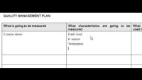
https://www.youtube.com/watch?v=ziFvAulmbk0

Slide 12
2) QUALITY ASSURANCE
Quality assurance is a way of preventing mistakes and defects in manufactured products and avoiding problems when delivering products or services to customers; which ISO 9000 defines as "part of quality management focused on providing confidence that quality requirements will be fulfilled"

Slide 13
3) QUALITY CONTROL
Quality control (QC) is a process through which a business seeks to ensure that product quality is maintained or improved. Quality control requires the company to create an environment in which both management and employees strive for perfection. This is done by training personnel, creating benchmarks for product quality, and testing products to check for statistically significant variations.

Slide 14

https://www.youtube.com/watch?v=rkieMbKZFeg&t=41s

Slide 15
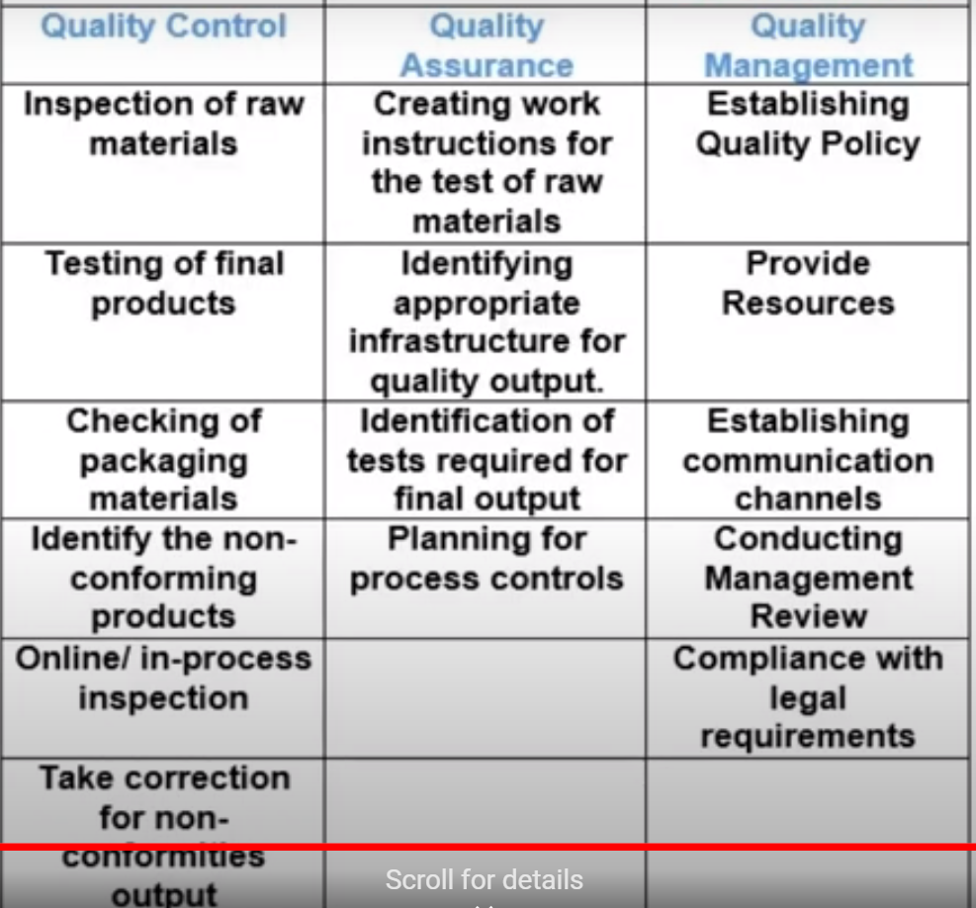

Slide 16
GROUP WORK
Prepare a quality management plan for your project using a simple template consisting of the following:
What is going to be measured
What characteristics will be measured
What quality control processes will be used to measure quality

